Slide 1
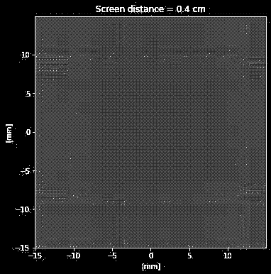
Geraldez-LK-2019-11336 157-WFY-FX-1 ~ (digital-eyes)
Digital Image Formation and Enhancement
digital-eyes:~# A plethora optical information remains hidden from our eyesight. Here, we explore them using digital vision.
!WARNING! The following presentation contains flashing lights and fast-moving visuals that may trigger seizures or cause discomfort to individuals with photosensitive epilepsy. Viewer discretion is advised.
discussion-format:~# Throughout the exploration, image processing is first demonstrated with the corresponding code on a separate slide
GitHub repo: https://github.com/schwarzschlyle/image-processing

Slide 2
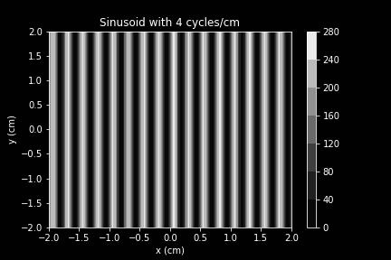
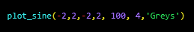
Geraldez-LK-2019-11336 157-WFY-FX-1 ~ (digital-eyes)
image-synthesis:~# Sinusoidal synthetic images are one of the most fundamental building blocks of any image. Similar to the decomposability of any function to a superposition of sines and cosines, images can be likewise decomposed to a sum of sine and cosine images. This can be taken advantages in compression, edge detection, and analysis which requires or can be aided by analyzing each frequency modes usually with the aid of a Fourier transform.
The constructed function takes in the meshgrid dimension, the number of total points per coordinate, the frequency of the sine wave, and the color scheme used to display the 0 to 255 pixel values. Here, we display a sinusoidal image with a frequency of 4 cycles per cm.

Slide 3
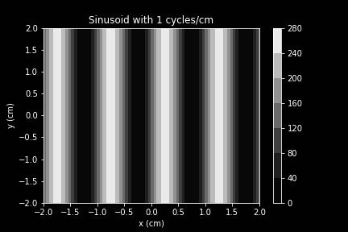
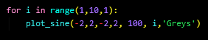
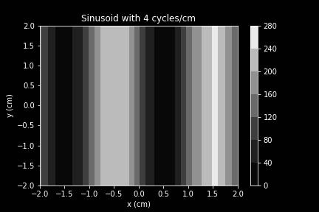
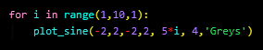
Geraldez-LK-2019-11336 157-WFY-FX-1 ~ (digital-eyes)
image-synthesis:~# Sinusoidal synthetic images are one of the most fundamental building blocks of any image. Similar to the decomposability of any function to a superposition of sines and cosines, images can be likewise decomposed to a sum of sine and cosine images. This can be taken advantages in compression, edge detection, and analysis which requires or can be aided by analyzing each frequency modes usually with the aid of a Fourier transform.
The rendered simulation sweeps through different frequency sine wave images from i=1 to i=9. Observe that, obviously, higher frequency sine wave images correspond to thinner lines.
Moreover, sweeping through different coordinate points at a fixed frequency of 4 cycles per second, one can observe the importance of resolution in terms of the number of points to appropriately synthesize an image.

Slide 4
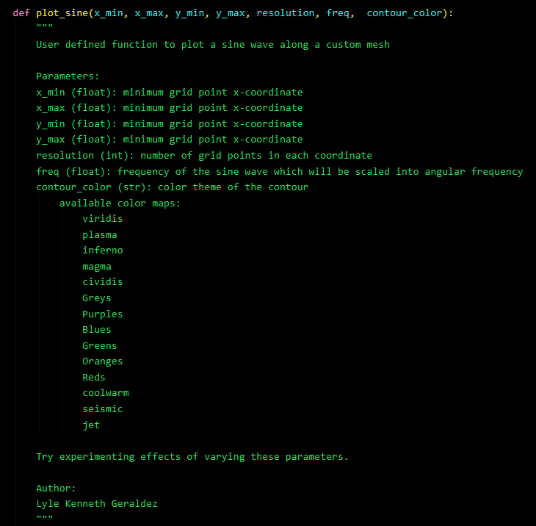
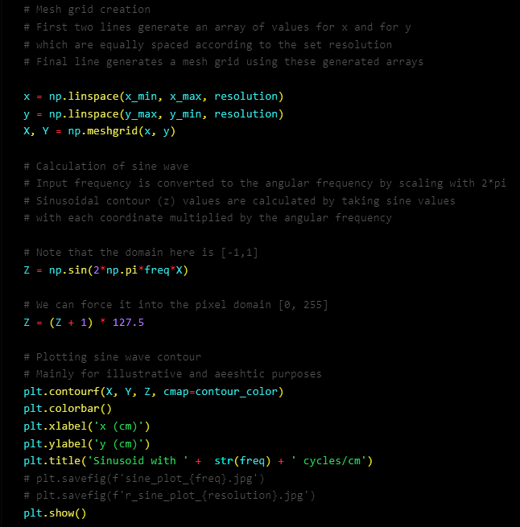
Geraldez-LK-2019-11336 157-WFY-FX-1 ~ (digital-eyes)
image-synthesis:~# code it yourself!

Slide 5
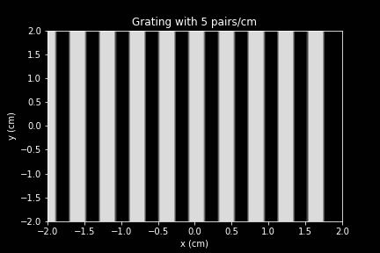
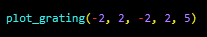
Geraldez-LK-2019-11336 157-WFY-FX-1 ~ (digital-eyes)
image-synthesis:~# Sometimes, images taken from a screen capture, from a website, or from a camera go through different lossy compression processes. Knowing how to construct synthetic images allow a pixel-precise image construction that is vital in a plethora of applications. This can be crucial in constructing accurate optical simulation by digital means
The function generates a uniform grating by fixing the grating interval to be equal to the grating width of each point. Here, the displayed image contains five pairs per cm totalling 10 pairs along the 2 cm by 2 cm grid.
Although it may seem like a rookie exercise in pixel-precise image synthesis via code, the discussion shows different forms of applications such as digital holography simulations and wave propagation simulations.

Slide 6
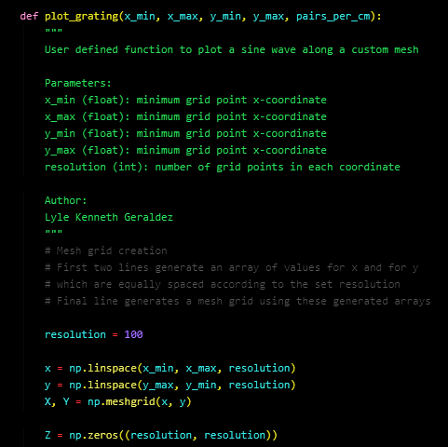
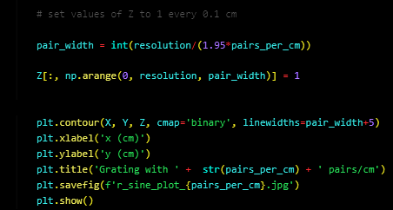
Geraldez-LK-2019-11336 157-WFY-FX-1 ~ (digital-eyes)
image-synthesis:~# code it yourself!

Slide 7
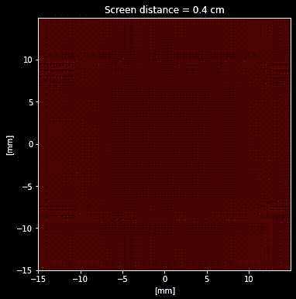
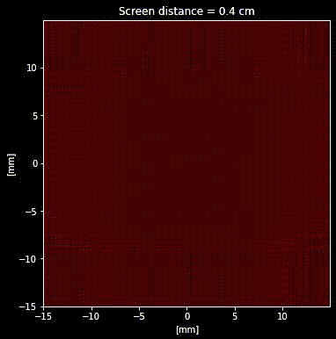
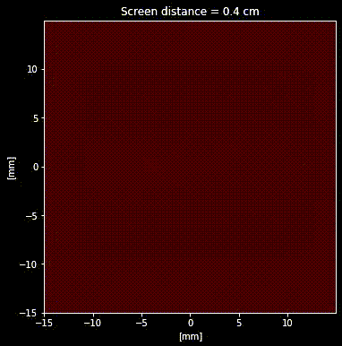
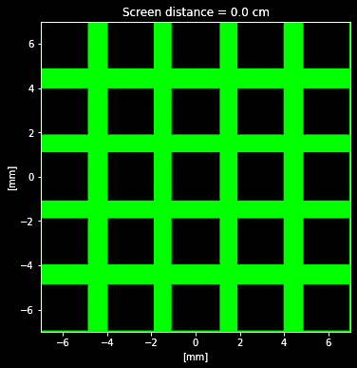
Geraldez-LK-2019-11336 157-WFY-FX-1 ~ (digital-eyes)
image-synthesis:~# Pixel-precise image synthesis is crucial in applied optics simulations such as with digital phase retrieval in a holography simulation or with digital wave propagation using the angular spectrum method as accurate pixel-to-intensity mapping is needed to properly conform with the governing equations.
The right simulation shows wave propagation in the green wavelength is it diffracts through a uniform grid slit. This is done using the angular spectrum method of wave propagation.
The simulation codes and report can be seen on the following GitHub repository.
Top simulations show digital holographic phase retrieval in the red wavelength using different optimization algorithms: from left to right, adam optimizer, conjugate gradient optimizer, and stochastic gradient descent optimizer
Applied optics GitHub repo: https://github.com/schwarzschlyle/applied-optics

Slide 8
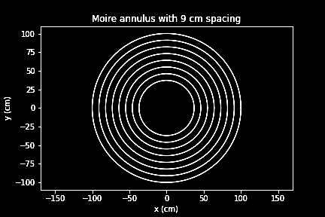
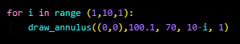
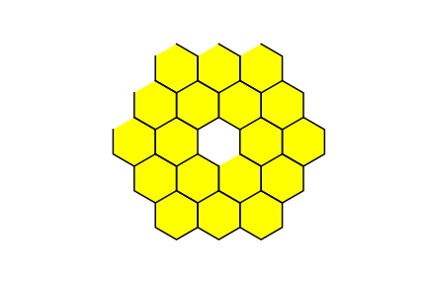
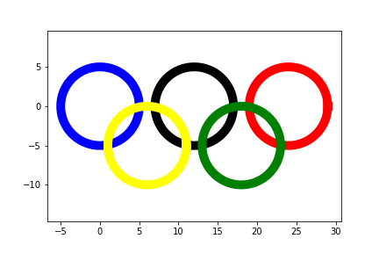
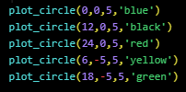
Geraldez-LK-2019-11336 157-WFY-FX-1 ~ (digital-eyes)
image-synthesis:~# Here are a few more synthesized images. Of course in most applications, one must tap into the RGB color channels to shade each pixel with a desired color.
With proper code construction, one can synthesize an annulus (even with a Moire effect) to synthesize the Hubble primary mirror,
... or draw a custom hexagonal array to synthesize the JWST primary mirror,
... or draw connected circles to synthesize the Olympics logo.

Slide 9
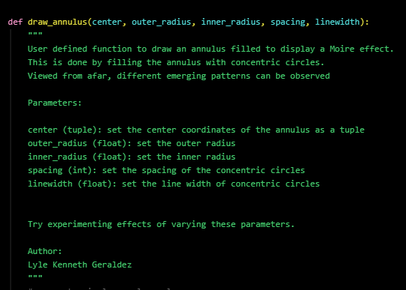
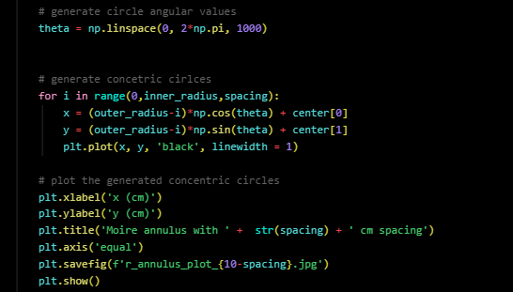
Geraldez-LK-2019-11336 157-WFY-FX-1 ~ (digital-eyes)
image-synthesis:~# code it yourself!

Slide 10
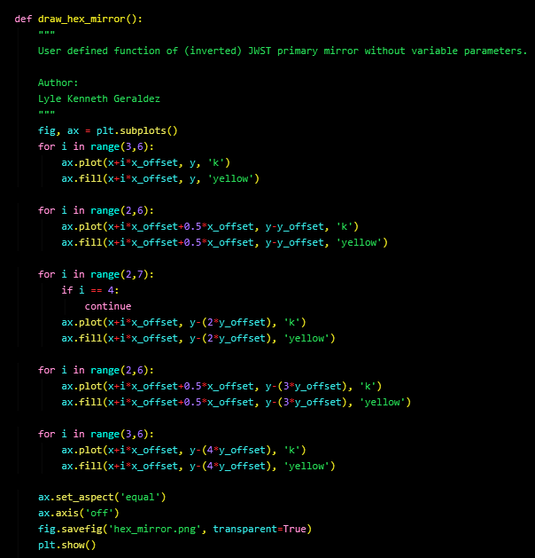
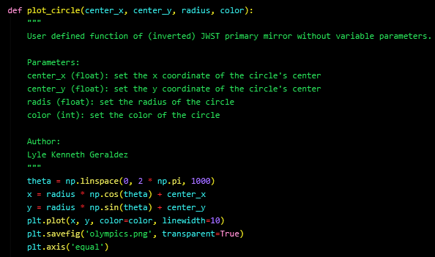
Geraldez-LK-2019-11336 157-WFY-FX-1 ~ (digital-eyes)
image-synthesis:~# code it yourself!

Slide 11
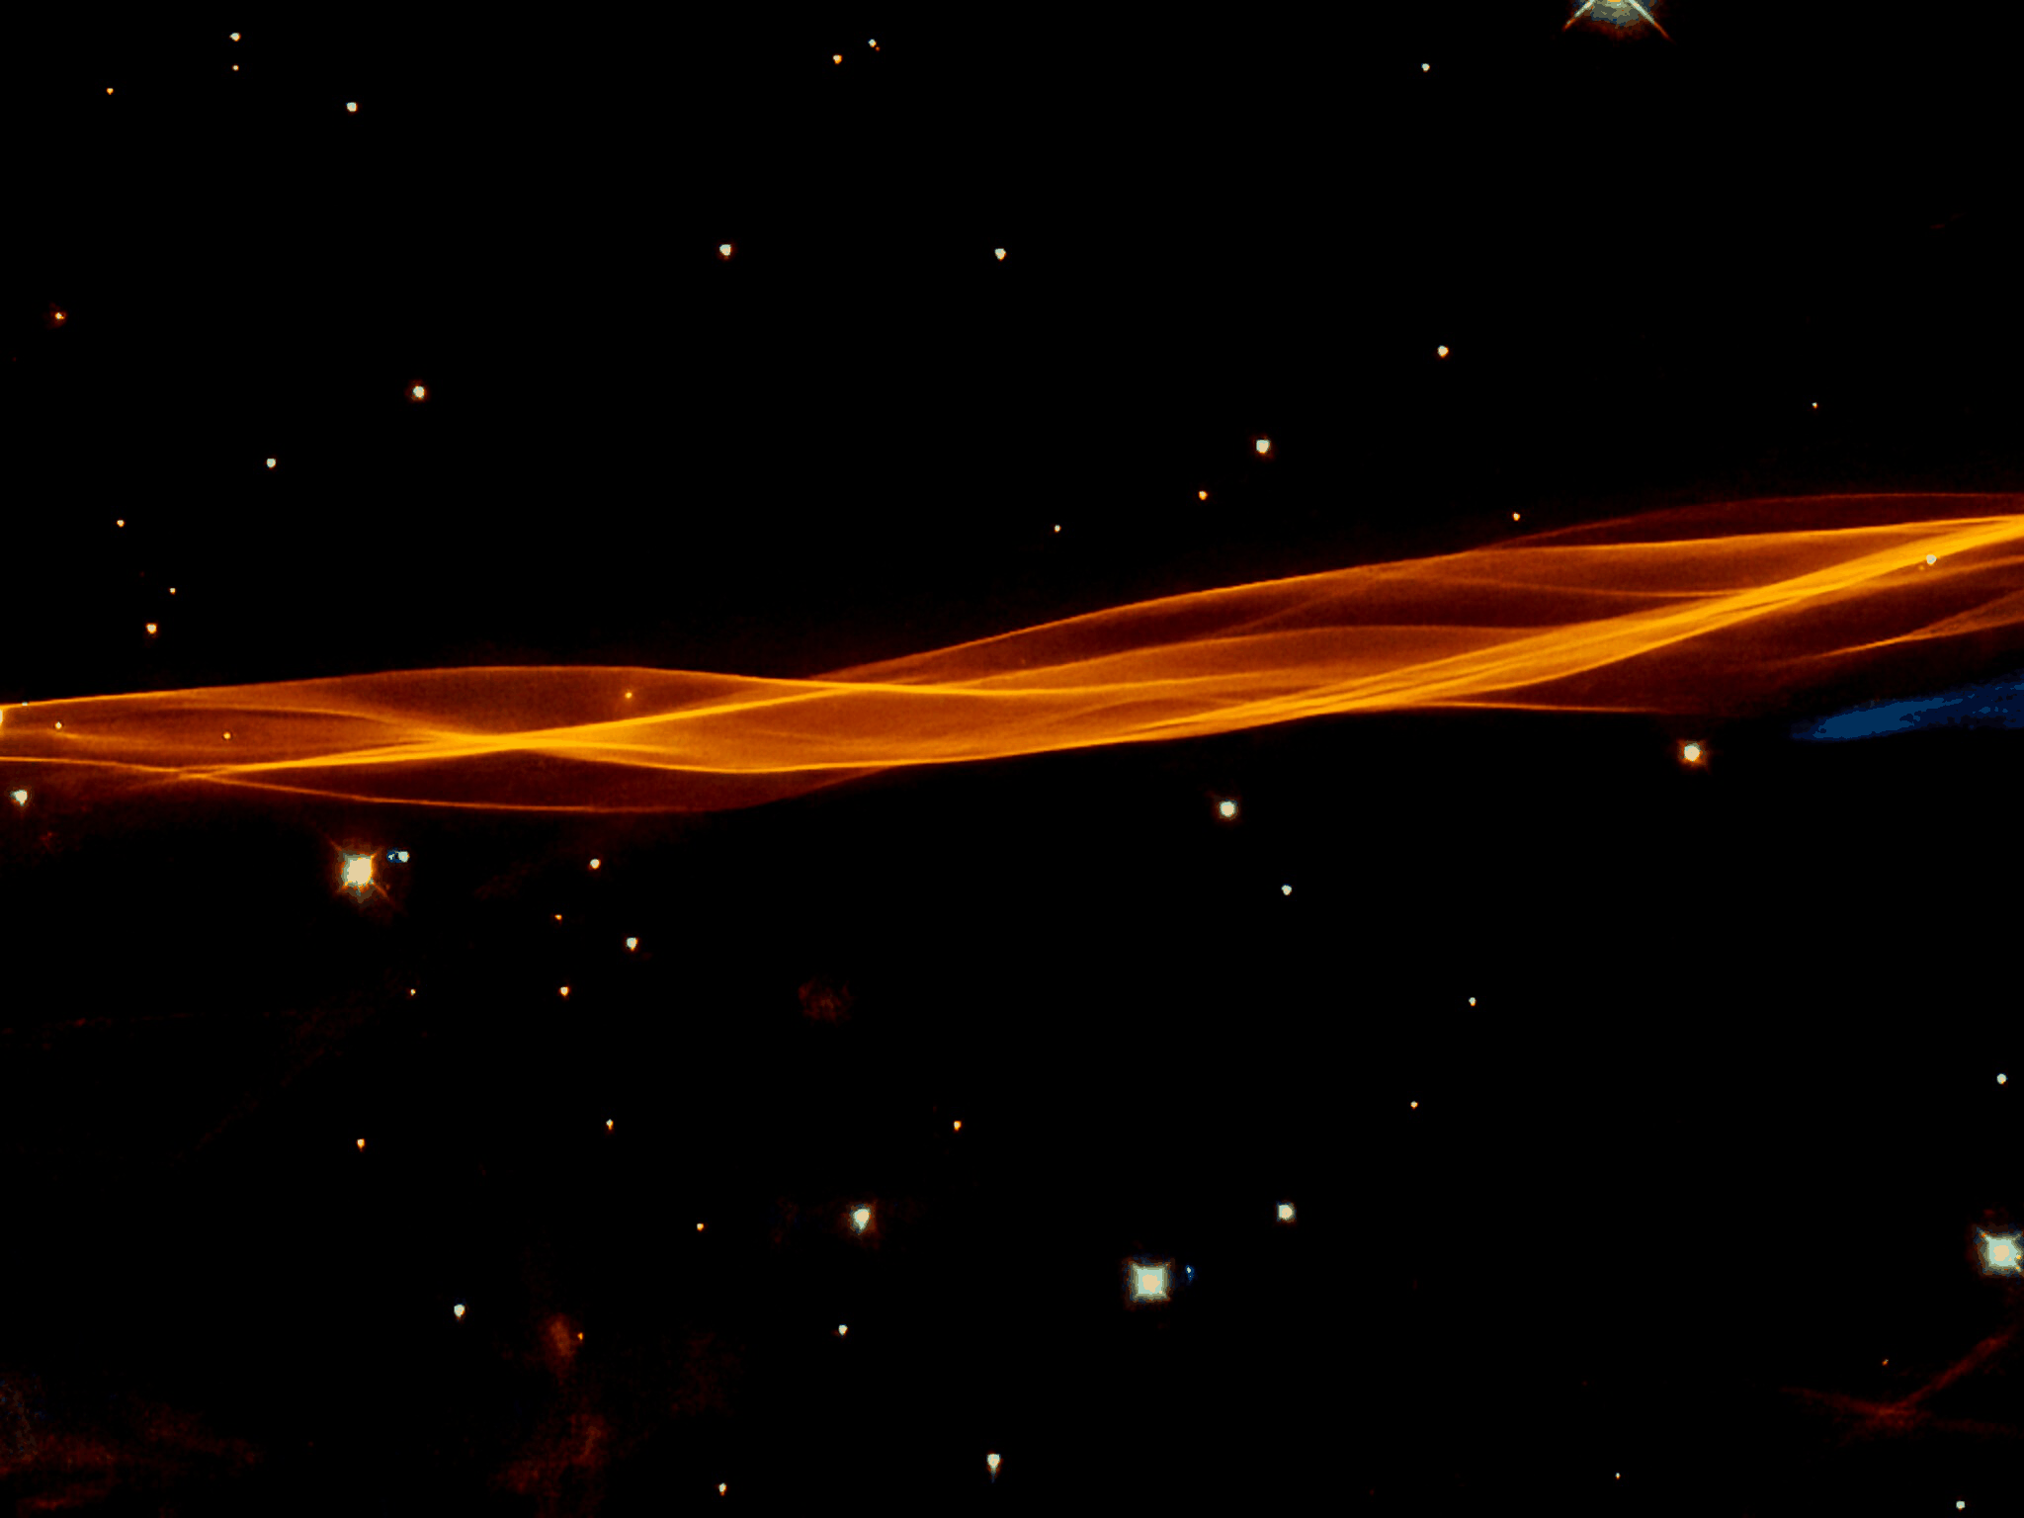
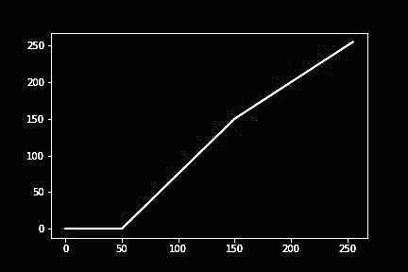
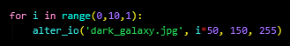
Geraldez-LK-2019-11336 157-WFY-FX-1 ~ (digital-eyes)
color-curve:~# Aside from the RGB pixel description of an image, one can also use an HSV (hue, saturation, value) description respectively describing pixel color, purity, and intensity. One way to enhance an image is by modifying its value channel which can be described by changes in its io curve.
Mimicking GIMP capability in python using three-point interpolated lookup table, this code varies the value channel by modifying the value = 50 pixel elements according to the for loop on the left.

Slide 12
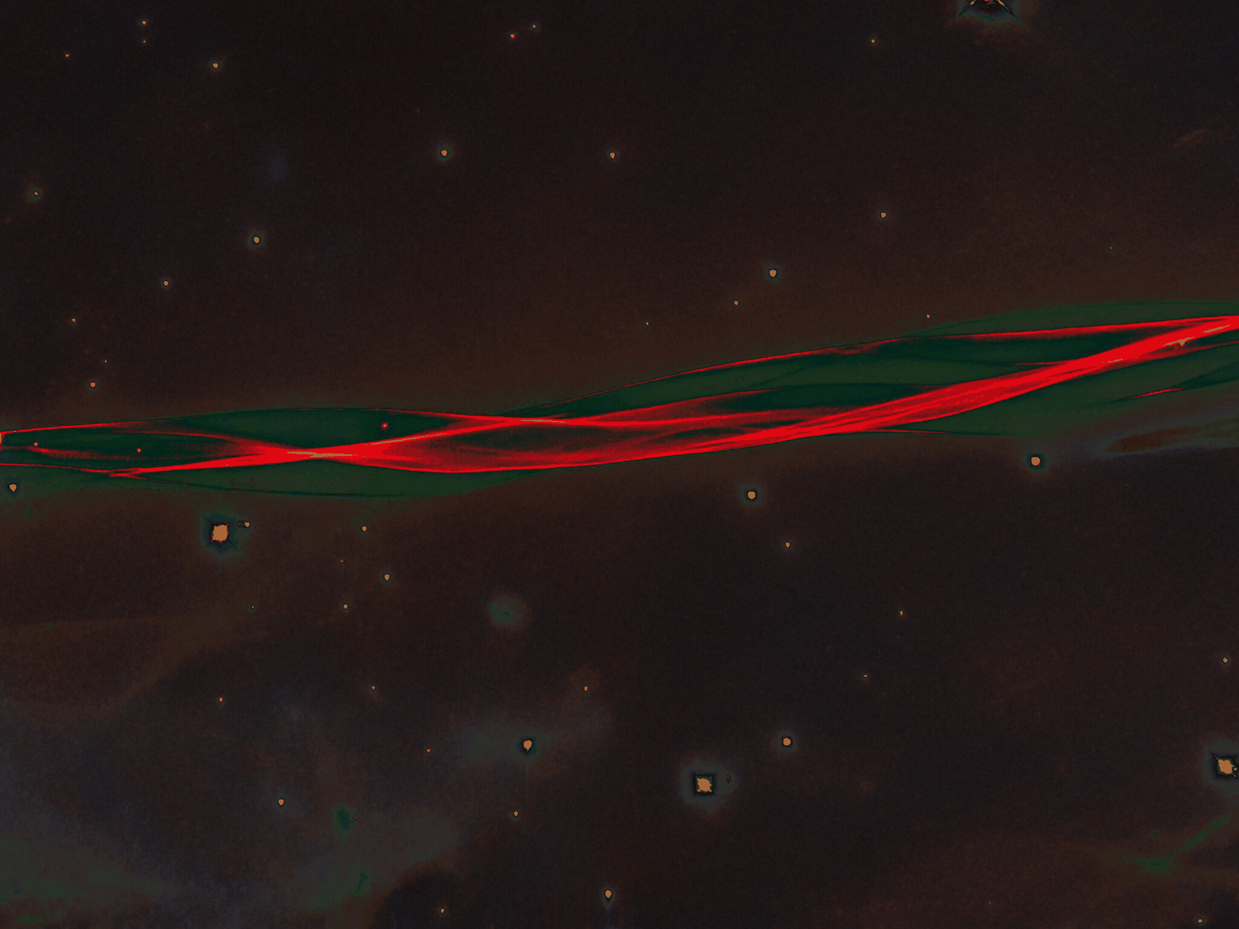
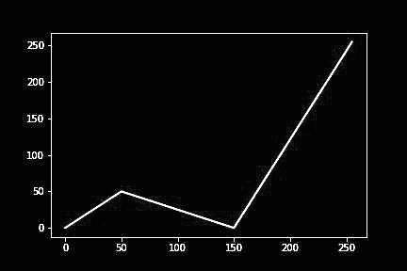
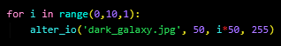
Geraldez-LK-2019-11336 157-WFY-FX-1 ~ (digital-eyes)
color-curve:~# Aside from the RGB pixel description of an image, one can also use an HSV (hue, saturation, value) description respectively describing pixel color, purity, and intensity. One way to enhance an image is by modifying its value channel which can be described by changes in its io curve.
Mimicking GIMP capability in python using three-point interpolated lookup table, this code varies the value channel by modifying the value = 150 pixel elements according to the for loop on the left.

Slide 13
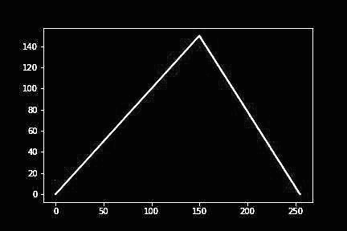
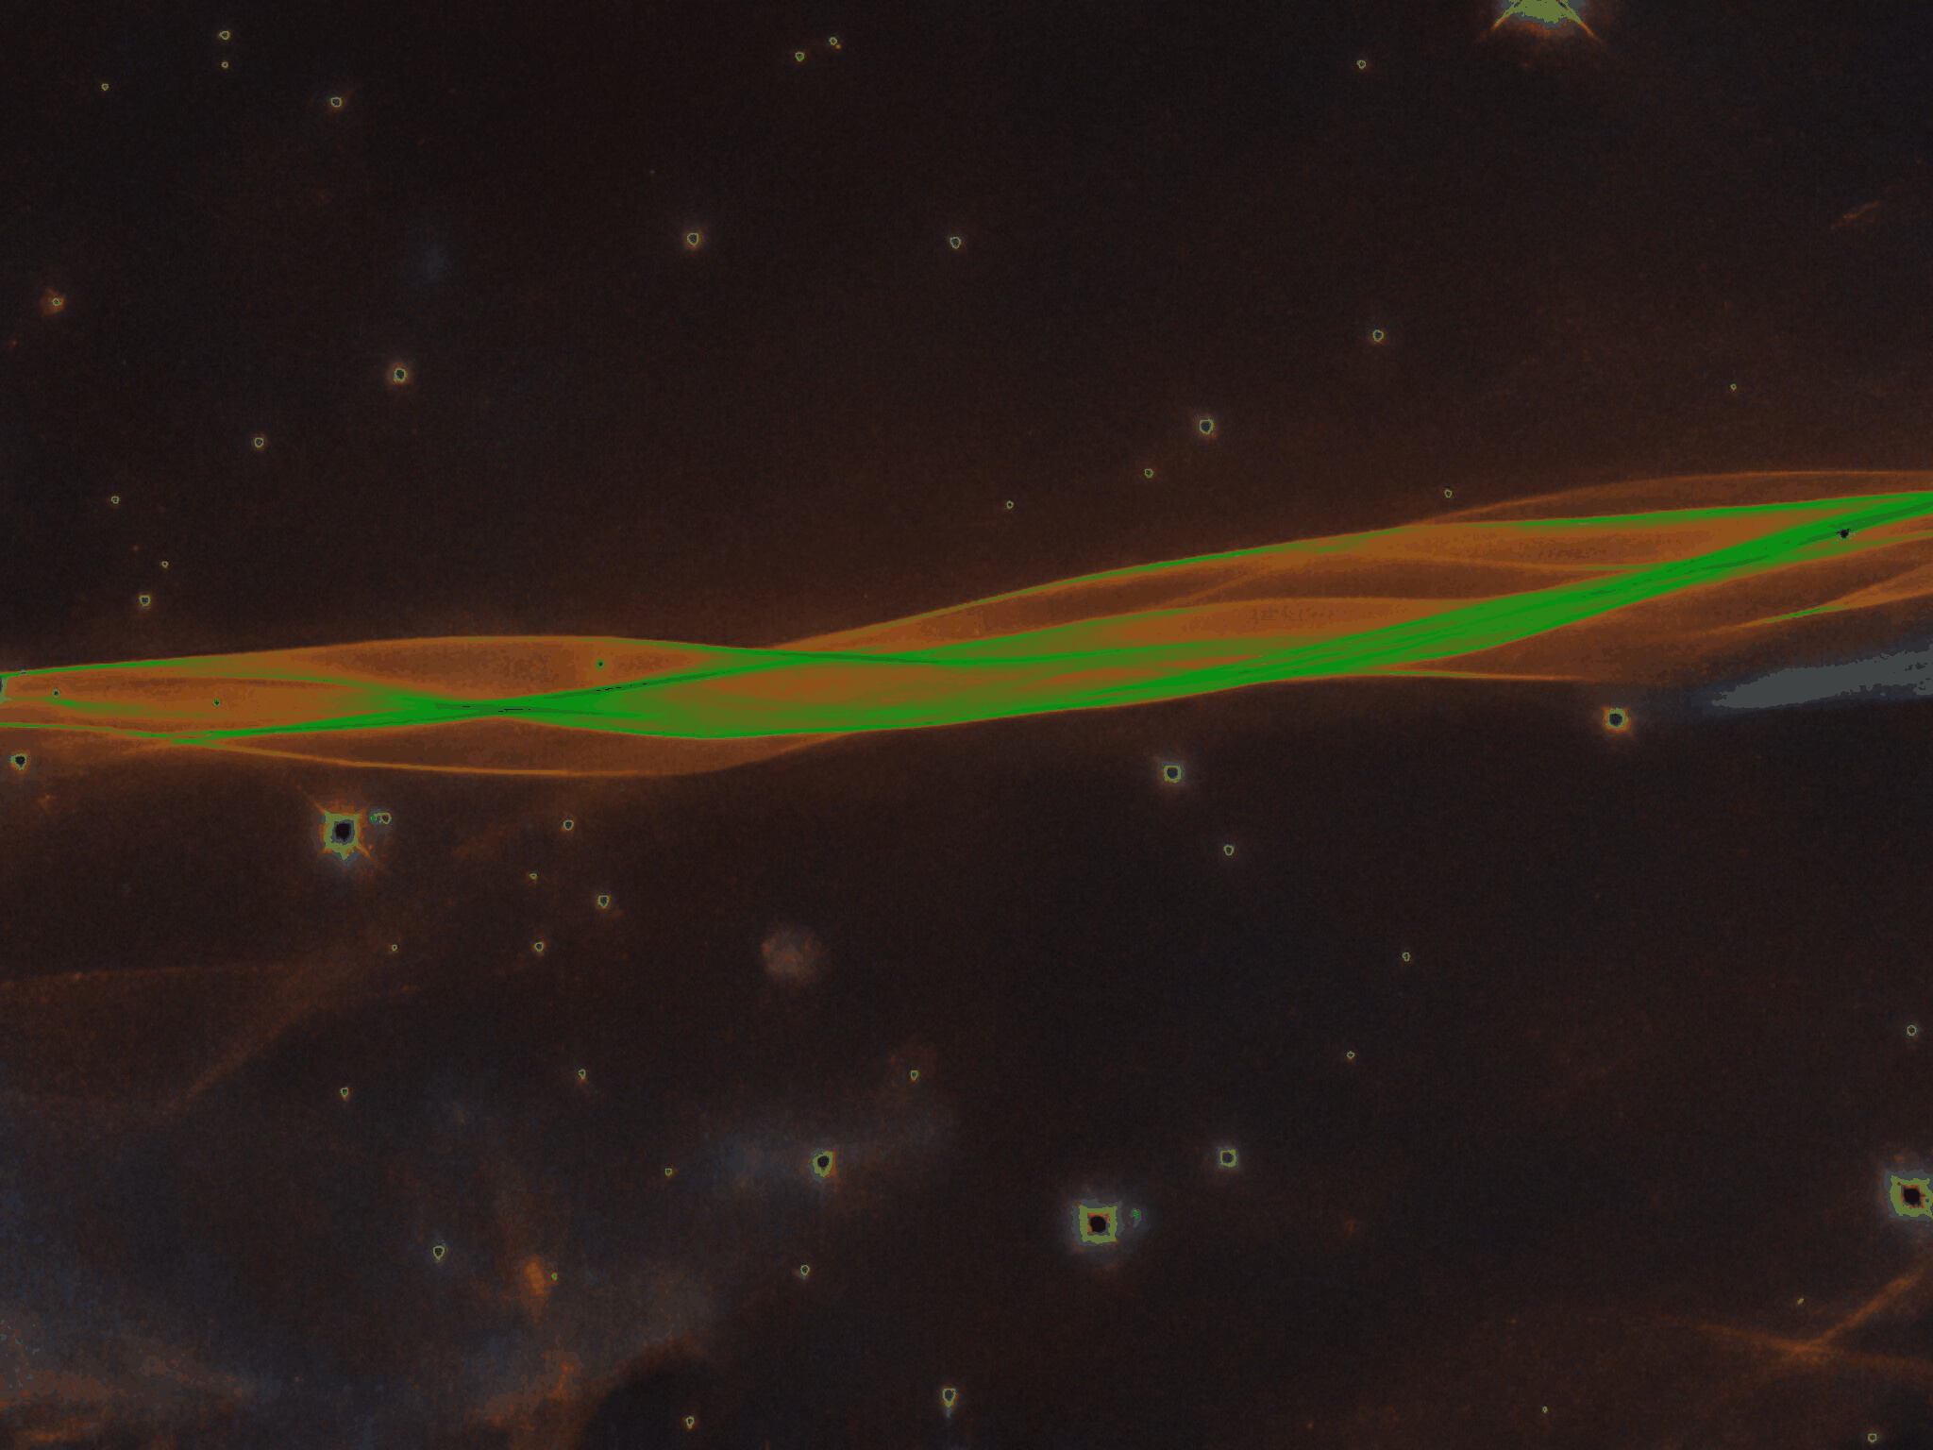
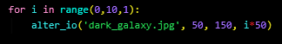
Geraldez-LK-2019-11336 157-WFY-FX-1 ~ (digital-eyes)
color-curve:~# Aside from the RGB pixel description of an image, one can also use an HSV (hue, saturation, value) description respectively describing pixel color, purity, and intensity. One way to enhance an image is by modifying its value channel which can be described by changes in its io curve.
Mimicking GIMP capability in python using three-point interpolated lookup table, this code varies the value channel by modifying the value = 255 pixel elements according to the for loop on the left.

Slide 14
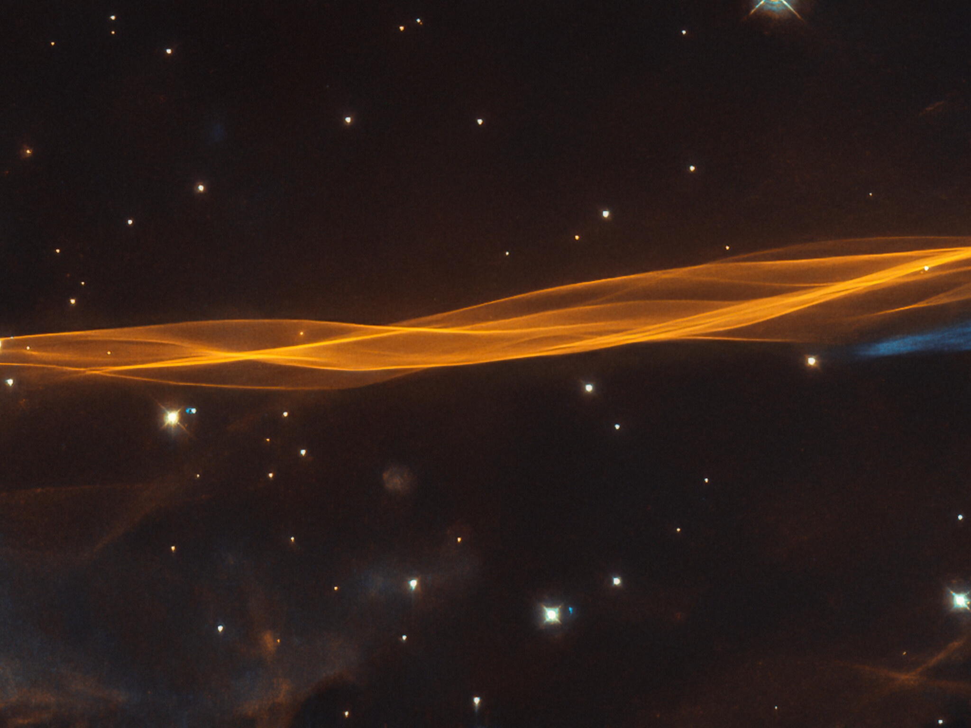
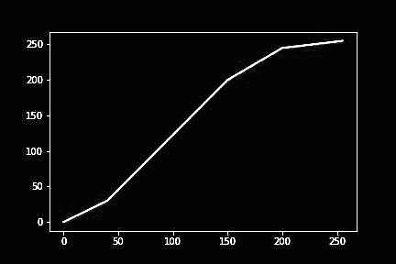
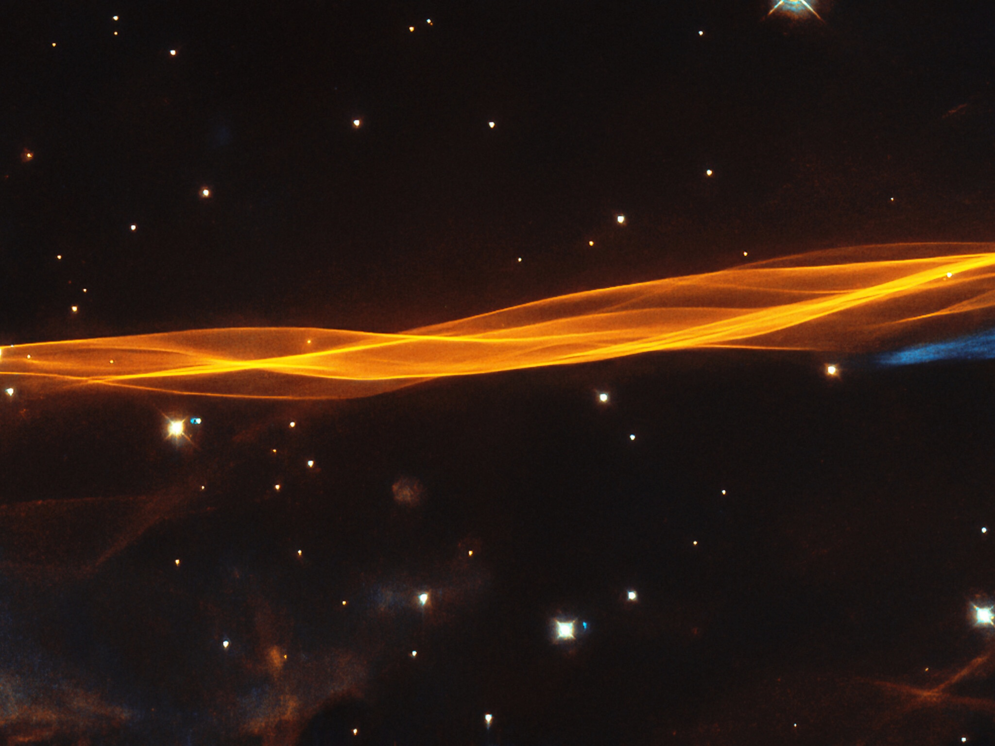
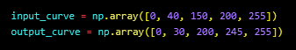
Geraldez-LK-2019-11336 157-WFY-FX-1 ~ (digital-eyes)
color-curve:~# Aside from the RGB pixel description of an image, one can also use an HSV (hue, saturation, value) description respectively describing pixel color, purity, and intensity. One way to enhance an image is by modifying its value channel which can be described by changes in its io curve.
From a series of numerical experimentation, the above five-point interpolation lookup table transformed to the image reveals more feature prominence of the now-crispier galaxy.

Slide 15
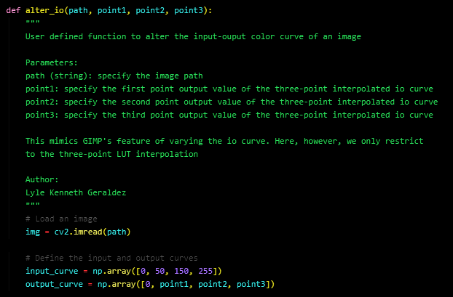
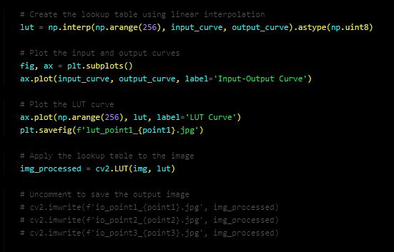
Geraldez-LK-2019-11336 157-WFY-FX-1 ~ (digital-eyes)
color-curve:~# code it yourself!

Slide 16
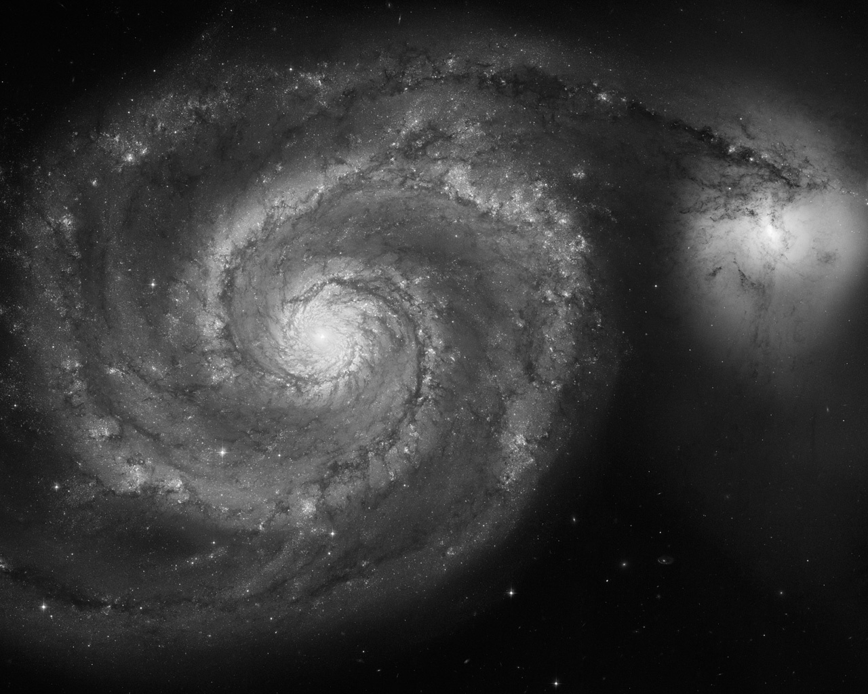
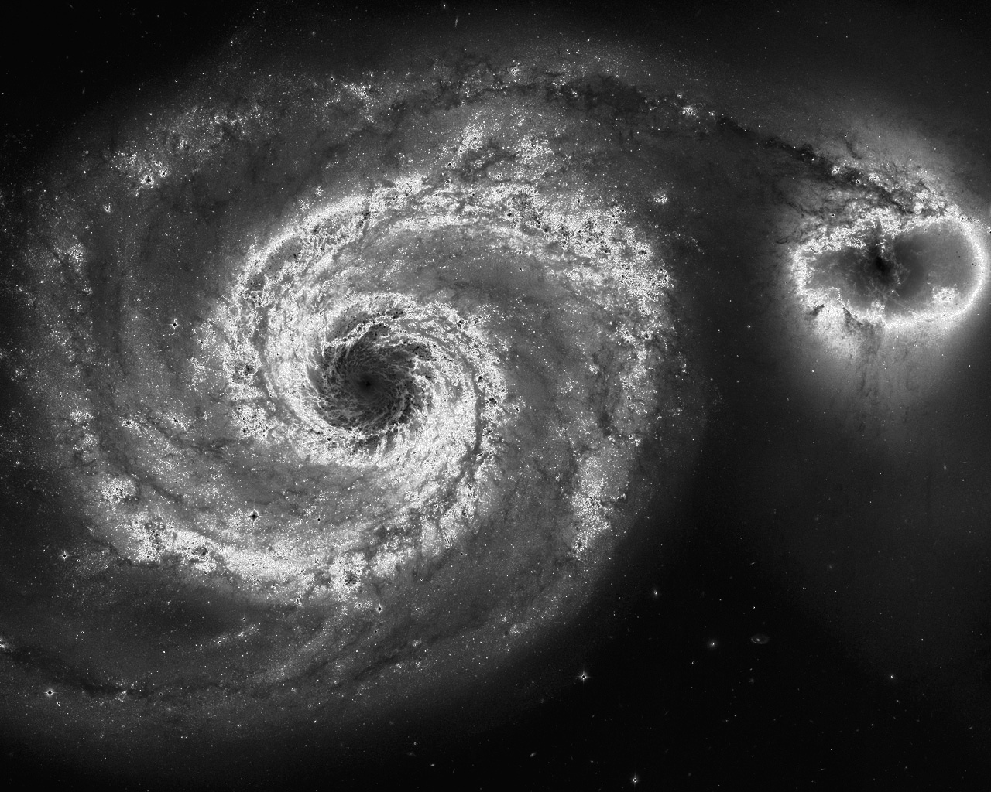
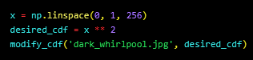
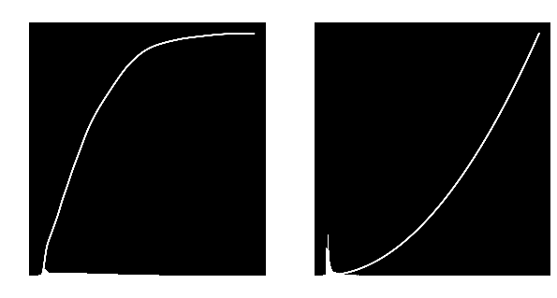
Geraldez-LK-2019-11336 157-WFY-FX-1 ~ (digital-eyes)
histogram-manipulation:~# Another way of image enhancement is through CDF backprojection. From a given histogram, one can calculate the PDF, and then the normalized CDF of an image. The calculated CDF can be transformed to another CDF shape via a lookup table.
User defined function of CDF backprojection takes in the image and the desired CDF as parameters. Here, we use an exponential CDF. Observe that the transformation increased the contrast and transformed the galaxy image to emphasize some features.

Slide 17
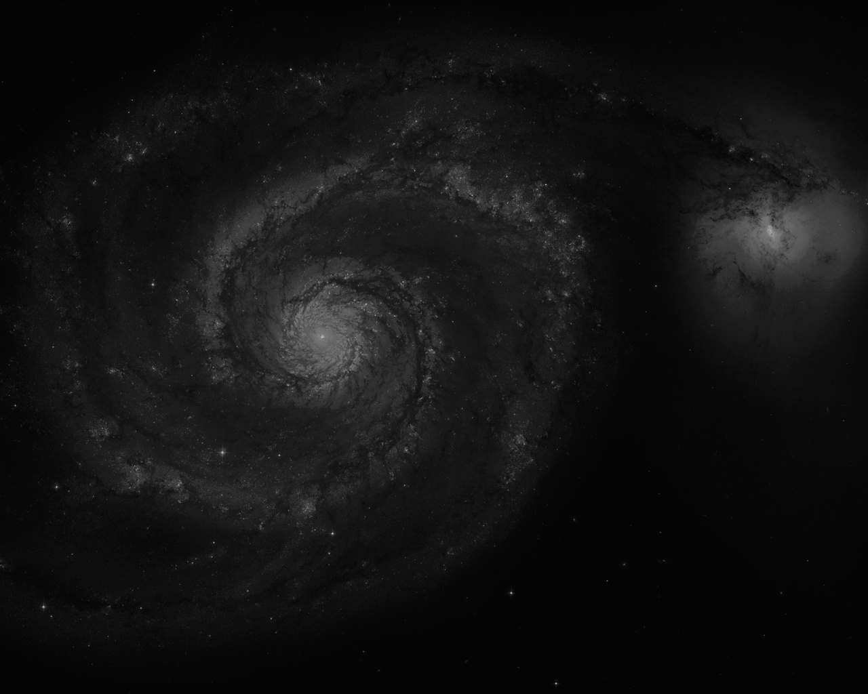
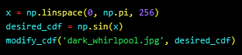
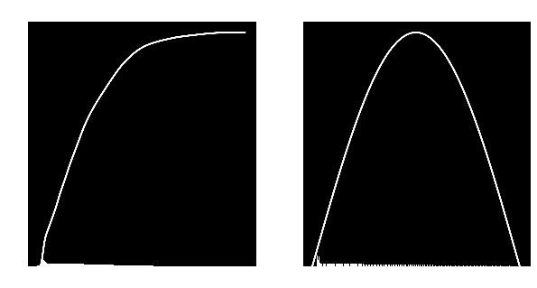
Geraldez-LK-2019-11336 157-WFY-FX-1 ~ (digital-eyes)
histogram-manipulation:~# Another way of image enhancement is through CDF backprojection. From a given histogram, one can calculate the PDF, and then the normalized CDF of an image. The calculated CDF can be transformed to another CDF shape via a lookup table.
Applying a sinusoidal CDF decreased the intensity and the contrast of the transformed image.

Slide 18
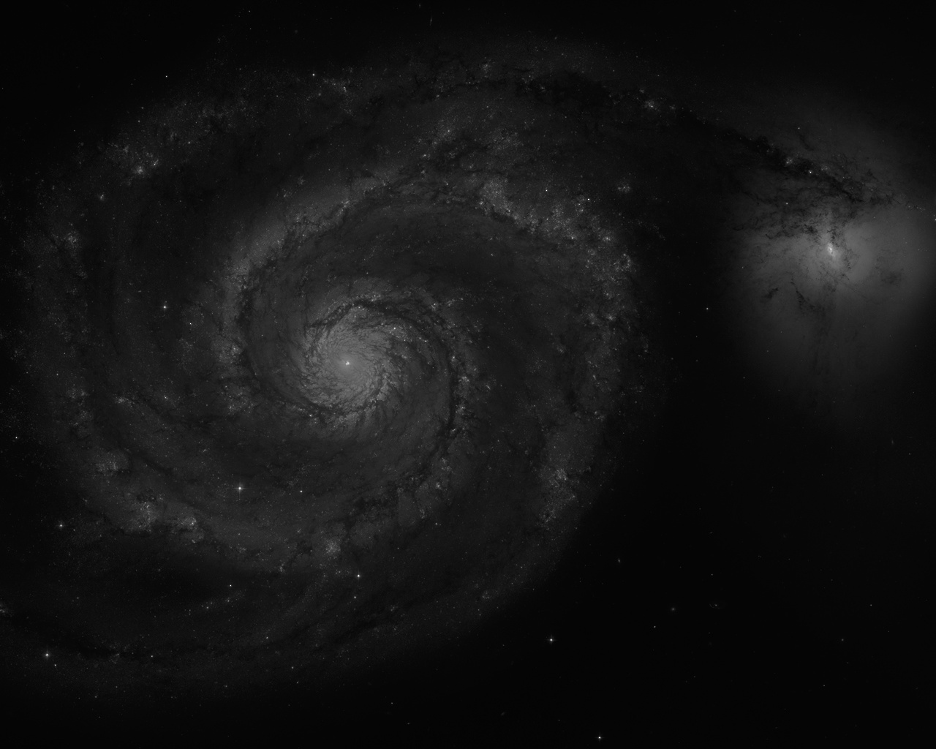
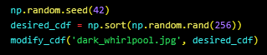

Geraldez-LK-2019-11336 157-WFY-FX-1 ~ (digital-eyes)
histogram-manipulation:~# Another way of image enhancement is through CDF backprojection. From a given histogram, one can calculate the PDF, and then the normalized CDF of an image. The calculated CDF can be transformed to another CDF shape via a lookup table.
One can also construct linear CDF with randomly-generated perturbation. Qualitatively similar to the sinusoidal image, the intensity and contrast decreased with the applied transformation.

Slide 19


Geraldez-LK-2019-11336 157-WFY-FX-1 ~ (digital-eyes)
histogram-manipulation:~# Another way of image enhancement is through CDF backprojection. From a given histogram, one can calculate the PDF, and then the normalized CDF of an image. The calculated CDF can be transformed to another CDF shape via a lookup table.
A linear CDF transformation apparently inverted the grayscale image (black became white; white became black).

Slide 20



Geraldez-LK-2019-11336 157-WFY-FX-1 ~ (digital-eyes)
histogram-manipulation:~# Another way of image enhancement is through CDF backprojection. From a given histogram, one can calculate the PDF, and then the normalized CDF of an image. The calculated CDF can be transformed to another CDF shape via a lookup table.
CDF transformation look up table must be properly constructed to fit the desired specific application although no one is stopping us in using a Legendre function CDF transformation for fun (or is it?)

Slide 21


Geraldez-LK-2019-11336 157-WFY-FX-1 ~ (digital-eyes)
histogram-manipulation:~# code it yourself!

Slide 22



Geraldez-LK-2019-11336 157-WFY-FX-1 ~ (digital-eyes)
contrast-enhancement:~# One way to increase the contrast of an image is by stretching out the grayscale pixel values such that the darker areas become darker and the lighter areas become lighter. In this new rescaling, each grayscale pixel value becomes transformed to a new one such that the pixel domain stretches from 0 to 255 thus increasing contrast
One way to increase the effects of contrast stretching is to consider an upper and lower percentile limit. This limiting of domain and mapping out the clipped minimum and maximum pixel value to 0 and 255, respectively, increases the contrast effects more which can be noticed by the increase in stretching of histogram (below rendered animation) corresponding to an image with a higher contrast (above rendered animation)
Defined function takes the lower and higher percentile limit as parameters which are varied to generate the animations.

Slide 23


Geraldez-LK-2019-11336 157-WFY-FX-1 ~ (digital-eyes)
contrast-enhancement:~# code it yourself!

Slide 24



Geraldez-LK-2019-11336 157-WFY-FX-1 ~ (digital-eyes)
contrast-enhancement:~# The same principle can be applied to each color channel (RGB). Rescaling each of the color channel by mapping the lowest and highest color value to 0 and 255, respectively, similarly stretches the histogram of each color channel. This increase the contrast of a colored image.
Instead of the grayscale value, the code now applies the transformation to each of the color channel and appropriately apply similar transformation.
Observe how the image becomes crispier with more contrast as the clipping percentile is varied to increase the stretching effects. Now, each channel histograms get stretches independently.

Slide 25


Geraldez-LK-2019-11336 157-WFY-FX-1 ~ (digital-eyes)
contrast-enhancement:~# code it yourself!

Slide 26



Geraldez-LK-2019-11336 157-WFY-FX-1 ~ (digital-eyes)
fade-restoration:~# One way to restore an image is to apply the discussed contrast stretching to each of the color channel to a faded photograph.
Similar code was used from the previously-defined contrast-stretching algorithm with (1,99) percentile clipping. Observe that although several features were made prominent, it still produces a sepia overall theme.

Slide 27

Geraldez-LK-2019-11336 157-WFY-FX-1 ~ (digital-eyes)
fade-restoration:~# Another method of faded photograph restoration is the gray world algorithm. With the assumption of a neutral gray being the average color, one can rescale each color channel by the corresponding average of each channel across the image. This produces a fade-reversion by re-balancing the image to reduce the appearance of fade-related color perturbation.
Gray world algorithm function calculates the average of each color channel and rescales each color channel by the respective averages. To scale them back to 0 to 255 domain, a rescaling factor (128) is applied. Observe that the sepia theme disappeared revealing a grayscale version of the image (which, I presume, may have originally been a grayscale image all along)

Slide 28


Geraldez-LK-2019-11336 157-WFY-FX-1 ~ (digital-eyes)
fade-restoration:~# Instead of rescaling by the average value of the color channel, we can rescale them by the average value of the color only from a known white patch. Here, we choose a small square along Einstein’s eyes as white patch.
The function applies the white-patch rescaling which also takes the coordinate sides of the white patch rectangle. Corresponding code slide shows snippet of coordinate extraction from an image. Needless to say, the eye white patch choice failed.

Slide 29
Geraldez-LK-2019-11336 157-WFY-FX-1 ~ (digital-eyes)
fade-restoration:~# code it yourself!

Slide 30

Geraldez-LK-2019-11336 157-WFY-FX-1 ~ (digital-eyes)
fade-restoration:~# code it yourself!

Slide 31


Geraldez-LK-2019-11336 157-WFY-FX-1 ~ (digital-eyes)
fade-restoration:~# code it yourself!

Slide 32
Geraldez-LK-2019-11336 157-WFY-FX-1 ~ (digital-eyes)
technical-correctness:~# The report objectives were properly achieved (and then some) with concrete results in the form of produced images and rendered animations. For some methodology, the images were seen to be qualitatively enhanced by the appropriate transformation methods outlines on the manual. Moreover, methods where these enhancements fail lies not in the code implementation but that of appropriateness to a specific situation (such as in the white-patch algorithm or even the hypothesized sepia-originated faded photograph of Einstein’s image). Nevertheless, the required images were all rendered, compiled, and documented such that the validity and correctness can be verified. 35/35
quality-of-presentation:~# The temporal dimension is a powerful coordinate to make use when presentation information especially in the field of imaging. In contrast with presenting a series of disconnected snapshots, rendering them into a moving animated movie provides an intuitive essence which can be directly extract to supplement what a particular code, scheme, algorithm, or method is being tackle. However, I may be fooling myself if I don’t tell you that I did this mainly because it was super cool! At the heart of my trademarked black-and-neon themed presentation, images were well integrated seamlessly. The code snippet (mainly, function calling) was attached to each simulation. The called function defined are fully shown on a separate slide for transparency and ease of access although one can find a fully-explicit code running on the respective directories at the GitHub repository. 35/35
self-reflection:~# The report itself was constructed in a more narrative manner to include some aspect of self-reflection although the journey itself throughout the entire activity are being properly summarized in this page. There are some steps wherein some of the results were that of pure exploration (like applying a Legendre CDF to an image). The references for the used image was also properly cited. 28/30
initiative:~# The simulation results and some extended discussions related to other applied fields such as holography and digital wave propagation were included on the report. The written codes were all functionized for ease of calling and replication of results. These were properly commented and documented by an appropriate descriptive docstring. Together with the rendering of the images, this constitute different aspects of the report that went over the bare minimum objectives. 10/10
Total: 108/100
references:~#
dark_galaxy.jpg: "Featured Image: Star Clusters in M51" (2016). [Image]. Retrieved from https://aasnova.org/2016/06/20/featured-image-star-clusters-in-m51/
dark_whirlpool.jpg: "NGC 5195" (2009). [Image]. Retrieved from https://en.wikipedia.org/wiki/NGC_5195
faded_einstein.jpg: "Einstein, Albert" (Unknown). [Image]. Retrieved from https://einstein.manhattanrarebooks.com/pages/books/20/albert-einstein/photograph-signed

